Slide 1
CS 513 Assignment 2
Map Matching & Road Slope
By: Theo Guidroz, A20426895
Hunter Negron, A20417545
Zhengcong Xiao, A20453141

Slide 2
Contents
Introduction
Background & Motivation
Approach & Methodology
Results
Conclusion
References

Slide 3
Introduction
Problem Statement
Understanding what Probe Data is
Understanding what Link Data is
We need to map match probe points to road links
We need to derive road slope for each road link
We need to evaluate the derived road slope with the surveyed road slope in the link data file

Slide 4
Probe Data
This is data generated by monitoring the spatial and temporal position of a moving object. These moving objects can be used for information collection by special vehicles.
A single probe point consists of probe ID, latitude, longitude, altitude, date time, source code, speed, heading and so on.
If we need to reinforce the accuracy of the current road network, the incoming probe data must correspond to the correct link in the road network.

Slide 5
Link Data
Link data is used to describe ways to expose and connect data from different sources on the Web.
"Link" is a set of GPS coordinates that indicate a road section or constitute a road curve.
It is the information of the road interval. This includes data for links that match the probe points.
It has different attributes, such as linkPVID, length, directionOfTravel and so on.

Slide 6
Introduction
Goals
We have to map matching probe points to road links.
Then, the slope of each road section should be derived.
Finally, we evaluate the derived road slope based on the road slope measured in the linked data file

Slide 7
Introduction
Provided Data
We were given two CSV files, one representing probe point data collection from GPS and other sensors on cars and cellphones, and one representing the information describing the links in a road network.
The probe points, due to natural error in the the data collection systems, is not perfecting aligned with the road network. Therefore, the first step should be to match the probe points with a the most likely link in the road network from where that point is collected.
Once the probe points are matched, we can then use probe elevation data to determine the slope of the road links at the given points.

Slide 8
Background & Motivation
Map Matching
Latitude and longitude are both showed on Probe data and Link data.
For map matching, we use the latitude and longitude information of the two files and compare them to the other files to find the pair with the smallest distance between them.
The pair is the result of the map matching link being consistent with the probe data points.

Slide 9
Background & Motivation
Road Slope
Using the matched point in the previous step, then two consecutive points is calculated.
Two methods to calculate the slope:
The slope between two consecutive points (P1, P2) is = 𝑅𝐼𝑆𝐸/𝑅𝑈𝑁 𝑖.𝑒. (𝑌2−𝑌1)/(𝑋2−𝑋1), where p1(x1,y1) p2(x2,y2) are two points.
Feeding a model with the difference in distance and height, and the length of the link. Then train the model.
The second method was chosen to counteract the presence of inaccurate data.

Slide 10
Approach #1: Brute-Force Proximity
Key Idea
Since the basic idea of map matching involves associating each probe point with a particular link in the road network, the most natural approach is to use a simple proximity-based algorithm. This can easily be implemented using the formula for finding the distance from a point (in our case, probe point) to a line segment (in our case, a link defined by its reference and non-reference nodes).

Slide 11
Approach #1: Brute-Force Proximity
Implementation
See “cs 513 hw 2 Notebook 1.ipynb” for the code
Followed the simplest map-matching algorithm presented in class
Proximity is based on a minimum perpendicular distance between a point and a line segment formula
Because every probe point was being checked against every road link, this method is extremely inefficient, resulting in a prohibitively long runtime.

Slide 12
Approach #2: Improved Proximity
Key Idea
After discussion regarding class lectures and reviewing our notes, and much time spent researching existing map matching algorithms online, we determined that our current simple approach had much room for improvement.
Not every probe point has to be checked against every road link.
An obvious simplifying assumption is that a single car/phone/probe on the road moves in a consistent manner; that is, it does not randomly jump between disparate links in the network

Slide 13
Approach #2: Improved Proximity
Key Idea Continued
A car/phone/probe can only travel to its current link (trivially) or to links that are directly connected (incident) to its current one.
Therefore, first determine which road links are incident to which other road links, then when iterating, a probe point only needs to be checked for proximity to those links that are incident to the link that was matched to the previous probe point.
Probe points must be checked in order sorted by timestamp.

Slide 14
Approach #2: Improved Proximity
Implementation: Pre-processing
Note, there are multiple revisions of this approach and they can be found in “cs 513 hw 2 Notebook 1.ipynb” and “cs 513 hw 2 Notebook 2.ipynb”
First, find all of the unique trajectories (indicated by the “sampleID” column in the probe points table) and sort all of the probe points by timestamp. A trajectory here is considered a collection of probe points collected in sequence from a single car/phone/probe traveling on the road network.

Slide 15
Approach #2: Improved Proximity
Implementation: More link data
Since the key to this approach is only checking for proximity against the links incident to the nearest link of the previous probe point, the link data must be analyzed to find which links are incident to which others.
Links are defined by a reference node and a non-reference node. Therefore, incident links will be sharing at least one of these, so iterate over the link data table, querying for other links that have the same reference or non-reference node and store all of their linkPVIDs in a list in a new column “incident” in the dataframe.

Slide 16
Approach #2: Improved Proximity
Implementation Continued
For each trajectory, match the first point against the entire road network. A probe can start at any point all must be checked for proximity. Keep track of which link nearest.
For each subsequent probe point of the same trajectory, get the list of incident links from the previous nearest link and only check those for proximity. This reduces the number of checks from hundreds of thousands to only a handful.
Performance is drastically improved; instead of running one probe point per second, this new approach runs roughly one trajectory per second.

Slide 17
Approach #3: Estimating the slope
See SlopeNeuralNetwork.ipynb for code
Train a neural network to estimate the slope
Using the information below from the Partition6467MatchedPoints.csv file:
Speed: Find the difference in speed between two consecutive probe data
Altitude: Find the difference in altitude between two consecutive probe data
Using the information below from the Partition6467LinkData.csv file:
Length: The length of the link
Discard all the rows with no information for the slope
Normalize the data used to train the model
Split the data into training and test sets
Train the model
Evaluate the model and change the parameters to increase accuracy

Slide 18
Results
Map Matching
The results for the map matching stage of the project are found in “Partition6467MatchedPoints.csv”. Due to the limitations of the Google Colaboratory environment, this CSV only represents a fraction of the probe points. Had runtime not been a constraint imposed by the python notebook execution server, we would have been able to easily return the full dataset. The completeness of the resulting CSV notwithstanding, these points are an accurate reflection of the correctness algorithm.

Slide 19
Results
Map Matching Shortcomings
While the final results provided here are the product of much time and effort to revise, edit, and reinvent our algorithms, we should acknowledge some pitfalls that will be found in the output dataset. Firstly, the “distFromLink “ column contains quite a few “-1”, which is postulated to be the result of an undetected error in the distance functions due to lack of rigorous testing of that specific module.

Slide 20
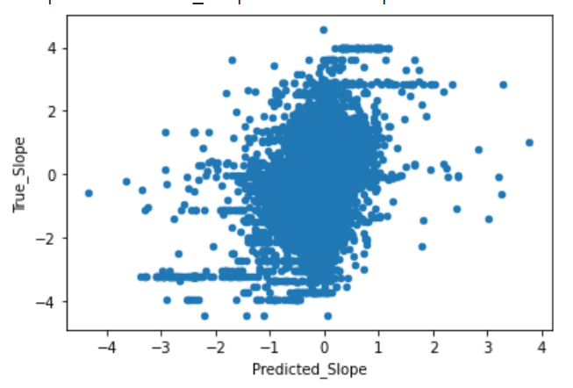
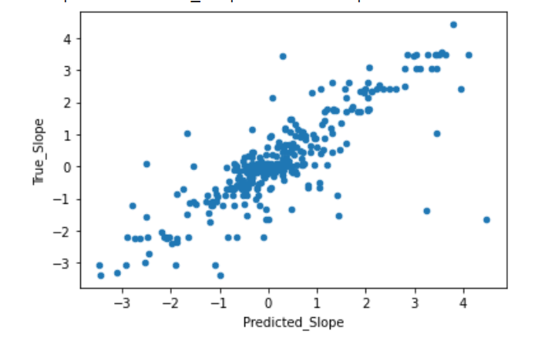
Results
Slope
While a portion of the match mapping data is accurate, some inaccuracy in the Matched csv file made the it hard to output predictions close to the true slope. The two graphs below show scatter plots of true slope vs predicted slope. Note that ideally, the graph would look similar to the line y = x
On the entire data set, the model struggles to output accurate slope estimation.
On a small amount of curated data, the graph looks similar to the line y =x.

Slide 21
Conclusion
The map matching calculations were accurate with some flaws. This lead to slightly less accurate slope prediction by the model. Unfortunately, the group did not possess enough computational power to run the entire data provided which caused the csv output files to be partially filled. Optimizing the algorithms would help solving this issue. Overall, the results produced by the algorithms were satisfactory but there is definitely room for improvement.

Slide 22
Conclusion
Further Steps:
The model used to calculate the slope would be more accurate if more link data had slope information. To remediate to the lack of slope information, k-fold validation could be used to train the model instead of dividing the set into two.
The final algorithm that we decided to use in order to map match the probe points is admittedly quite primitive, although it closely aligns with methods discussed in lecture. Beyond this assignment, it would be worthwhile to research other, more intelligent algorithms to produce more accurate map matched results that can be tailored to our specific dataset. Not only would this improve runtime, but also the accuracy so that there is a better chance that the slope algorithm will produce accurate results.

Slide 23
References
https://pandas.pydata.org/
http://www.vldb.org/conf/2005/papers/p853-brakatsoulas.pdf
“Map matching when the map is wrong: Efficient on/off roadvehicle tracking and map learning” (Paper on Blackboard)
https://www.geeksforgeeks.org/minimum-distance-from-a-point-to-the-line-segment-using-vectors/

